Slide 1
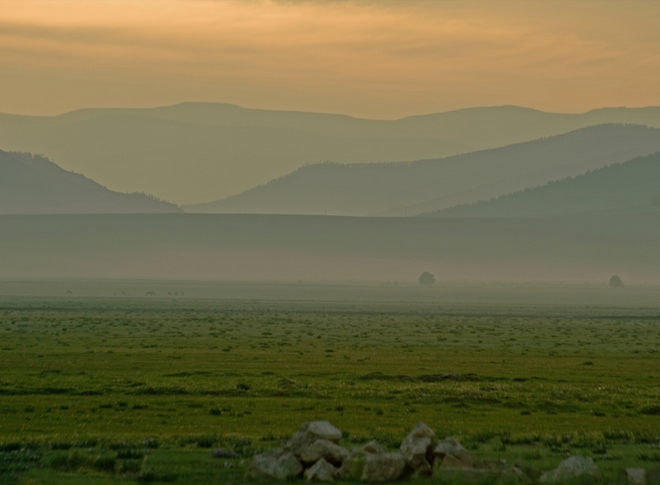

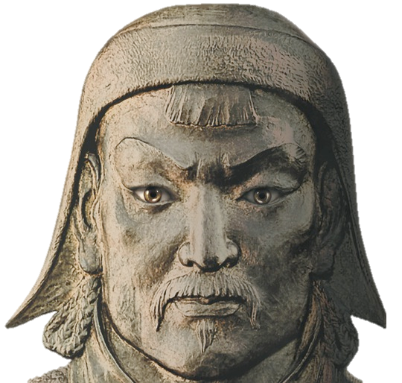
© Students of History - http://www.teacherspayteachers.com/Store/Students-Of-History

Slide 2

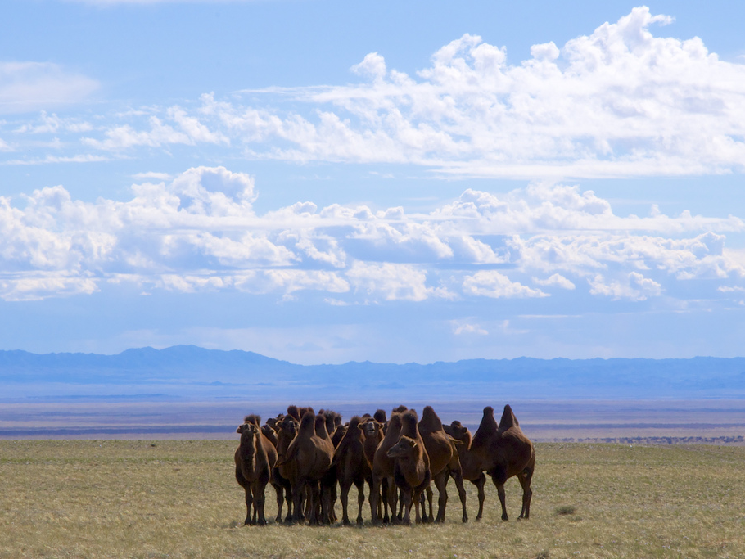

Small nomadic tribes who live in portable tents called “yurts”
Skillful herders of sheep, horses, and camels in the Central Asian steppe
Very aggressive to their enemies
Loosely organized into tribes and clans
lukerosa@gmail.com

Slide 3

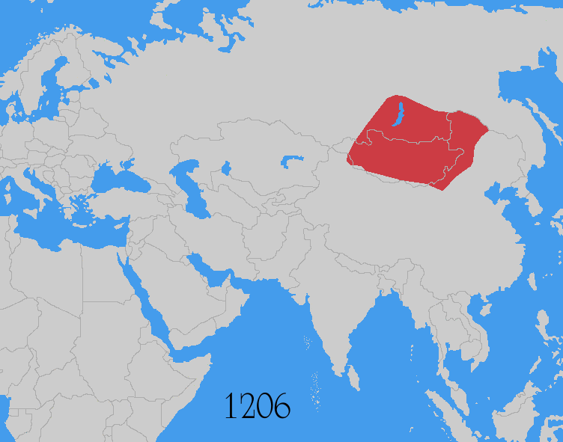

Slide 4
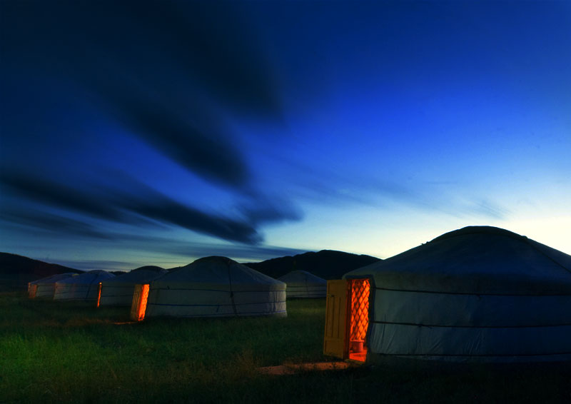

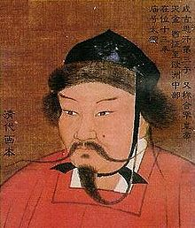
Born “Temujin” around 1162
His father was a clan chief
He becomes clan leader and defeats all his rivals to unify all of the Mongols around 1200
Takes on the title Genghis Khan or “universal ruler”
lukerosa@gmail.com

Slide 5

Used bows, arrows, and swords but also canons – a new technology
Skilled attacking on horseback
Often faked a retreat to lure enemies into a trap

Slide 6
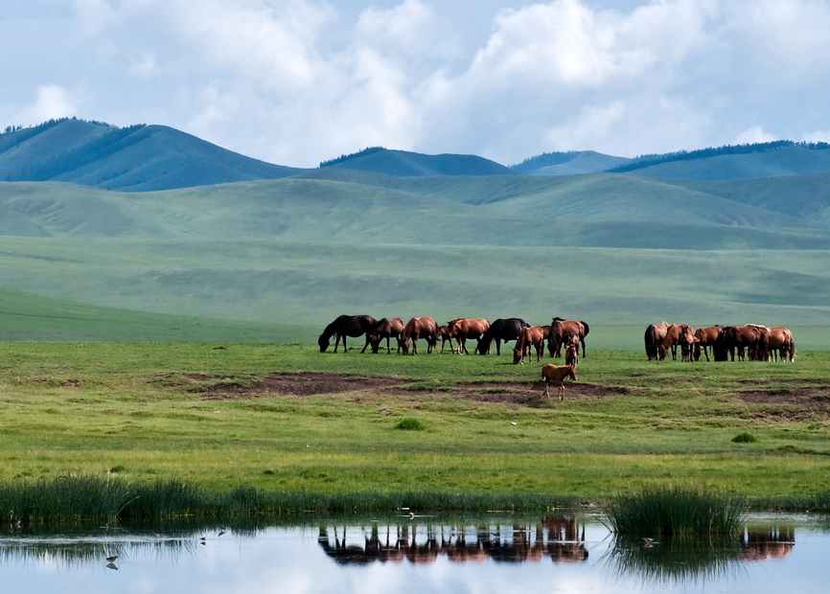
Genghis Khan created an elite group of 10,000 young warriors from all tribes loyal to him
Based military positions on merit, not your family
They showed no mercy to those who opposed but welcomed all who wanted to join
© Students of History

Slide 7
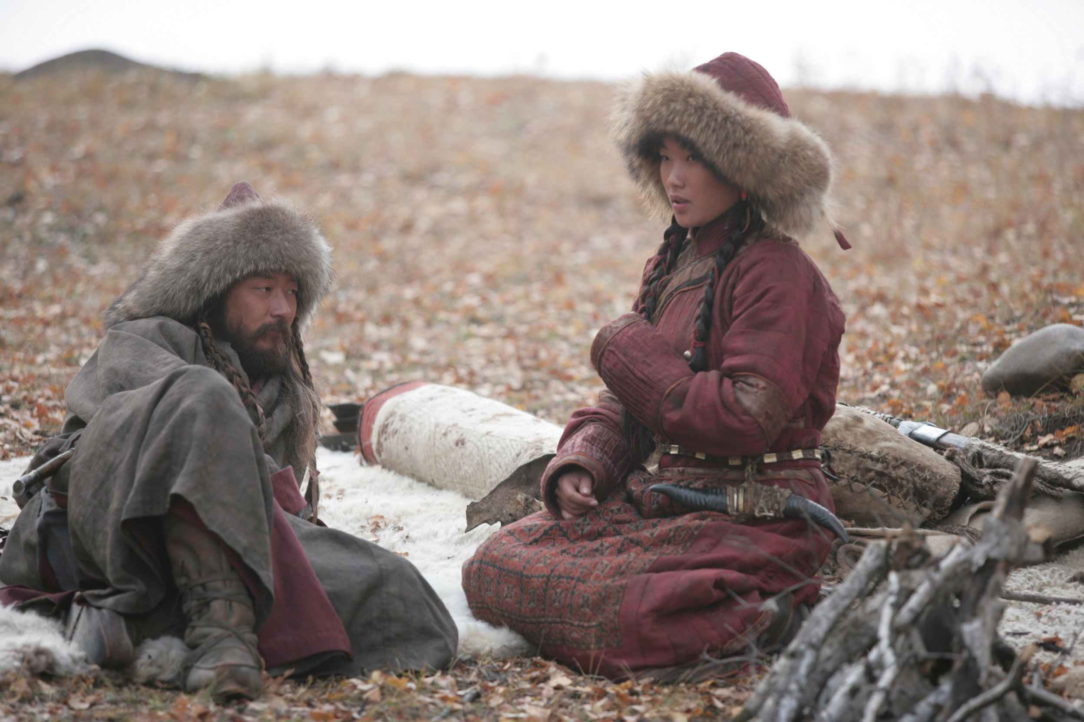


© Students of History
“The greatest happiness is to vanquish your enemies, to chase them before you, to rob them of their wealth, to see those dear to them bathed in tears, to clasp to your bosom their wives and daughters.”
-Genghis Khan

Slide 8
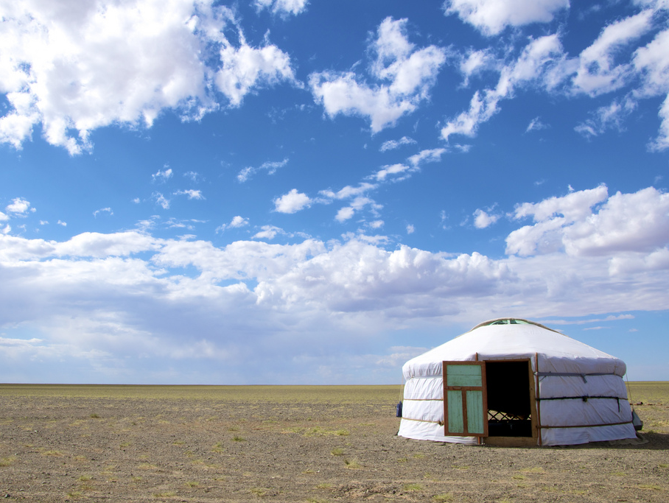

So who are the Mongols?
© Students of History
Attacked China in 1215 and burned 90 cities to the ground
Sacked and burned Samarkand and Bukhara, two great Silk Road cities in central Asia
Anyone who resisted was destroyed. Men executed, women sold as slaves
Anyone who submitted became a part of the Mongol empire (Korea)
The Mongols were nomadic tribesmen united in a loose federation.
When a leader emerged who could unite many tribes he was called Genghis Kahn or Universal Kahn. It is a title NOT a name.
The Mongol Empire was the largest land empire in history.
© Students of History - http://www.teacherspayteachers.com/Store/Students-Of-History

Slide 9
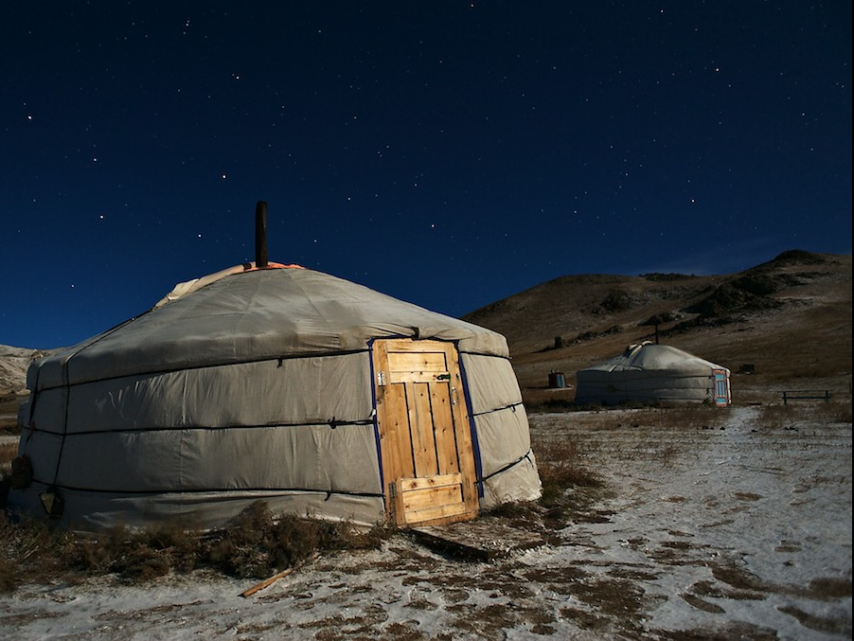

Become known as the “Golden Horde” because of the color of their tents
In 1279, Genghis Kahn’s grandson Kublai Khan conquered China, Tibet, & Vietnam
Founds the Yuan Dynasty in China

Slide 10
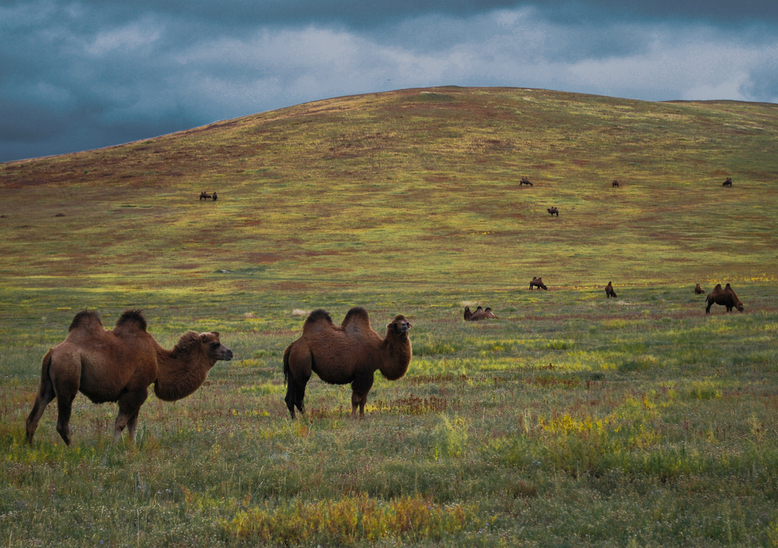

After Mongol conquest, 100 years of peace
Mongols policed the roads and made travel safe & Silk Road trade increased
Harsh punishments for criminals helped to deter crime
Unified parts of China, India, Central Asia, Muslim Middle East, & Russia- transmitting all acquired cultures and technologies.
© Students of History - http://www.teacherspayteachers.com/Store/Students-Of-History
© Students of History

Slide 11

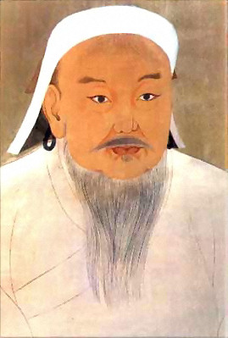
Forcibly relocated many artisans and merchants to central Asia
Created a written Mongol language
Practiced religious toleration- spread Buddhism, Islam & Daoism
The Mongol Mail system (later copied in US as Pony Express) unified Asia

Slide 12
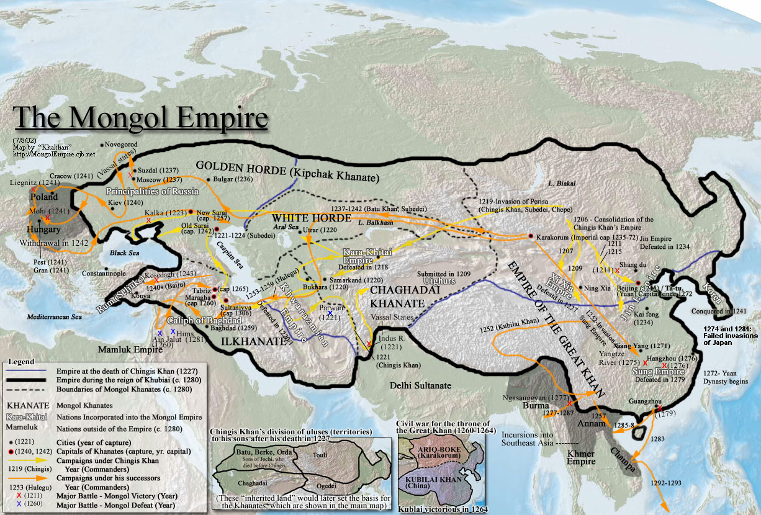
© Students of History - http://www.teacherspayteachers.com/Store/Students-Of-History

Slide 13
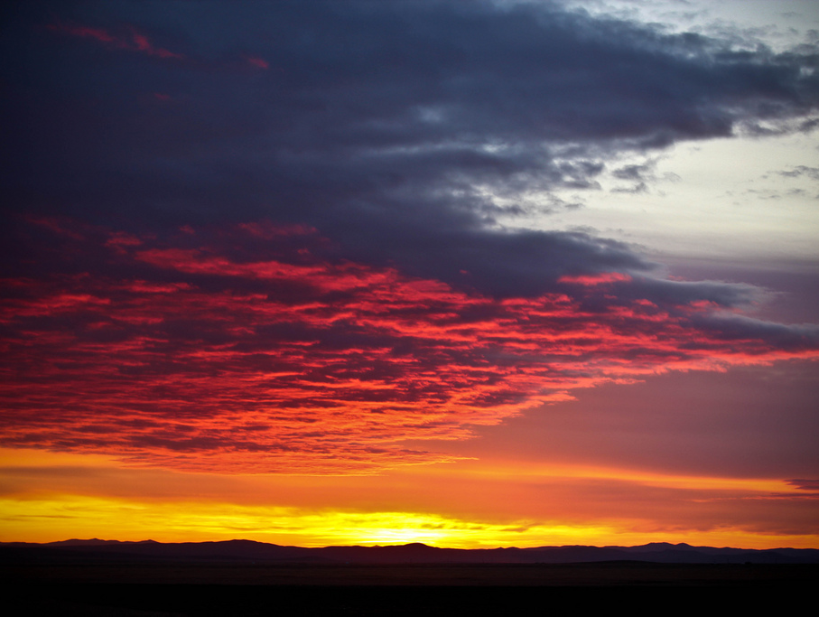

Empire divided into khanates
New leaders not as strong as Genghis or Kublai Khan
Resentment against Mongol rule grows in Russia and China
Empire becomes too big and diverse to manage

Slide 14

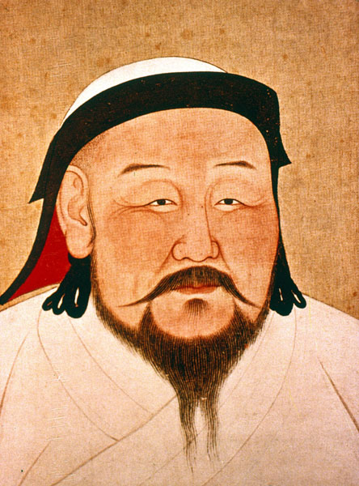
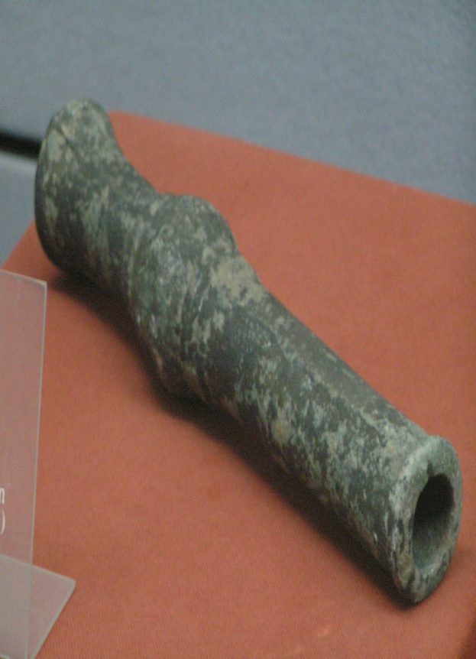
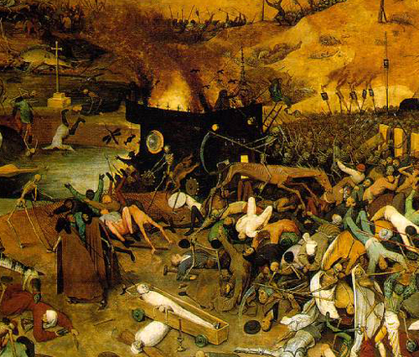
Kublai Khan (Timujin’s Grandson) established the Yuan dynasty in China and welcomed Marco Polo the Venetian explorer.
Gunpowder and cannons- invented in China and used by the Mongols
The Black Death- the Plague began in Asia but decimated Europe in 1347 killing 1/3 of the population

Slide 16
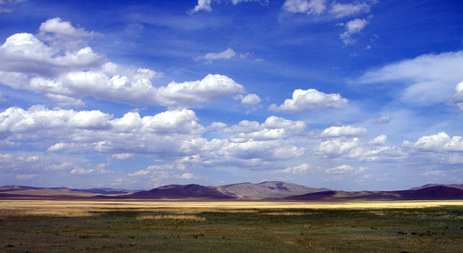

Respond to the following question in a well written paragraph:
Was Genghis Khan a great leader or a murderer?
Remember, a paragraph has 5 sentences, with a topic sentence, and at least 3 facts
© Students of History - http://www.teacherspayteachers.com/Store/Students-Of-History

